Slide 1
MID SEMester project presentation
BY
Komal Reddy (20103005)
Jayanth Reddy (20103010)
Jnana Yasaswini (20103023)
Akhila Banoth (20103052)

Slide 2

Design and Development of English to Telugu Translation System based on Transformer with Deep Learning

Slide 3
Aim and Objectives
PROGRESS
Architecture and Flow Diagram
Partial Results
Timeline
Conclusion and Future Work
CONTENTS

Slide 4
AIM AND OBJECTIVES

Slide 5
AIM
This project aims to create a proficient English to Telugu translation system using transformer architectures in deep learning. By bridging language gaps, it enhances communication and accessibility, offering an advanced tool for seamless translation between English and Telugu.

Slide 6
OBJECTIVES
Implement a transformer-based deep learning model for text translation.
Fine-tune the model to handle language-specific nuances and improve performance.
Implement appropriate evaluation metrics (e.g.,BLEU-score,accuracy)to quantitatively assess the translation quality.
Create an intuitive and user-friendly interface for users to input English text and receive the corresponding translated Telugu text.

Slide 7
PROGRESS

Slide 8
PROGRESS
Used Regex To Convert Contractions Into Natural Form
For example, won't to Will not
Created Custom Tokenizer Using Bert
Positional Encoding
Scaled Dot Product Attention
Multi Head Attention
Encoder and Decoder Layers
Feed Forward Network
Transformer Model

Slide 9
ARCHITECTURE AND FLOW DIAGRAM

Slide 10
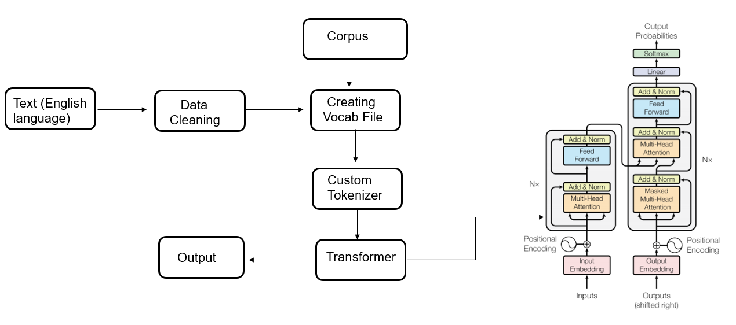
ARCHITECTURE AND FLOW DIAGRAM

Slide 11
PARTIAL RESULTS

Slide 12
ATTENTION MECHANISM

Slide 13
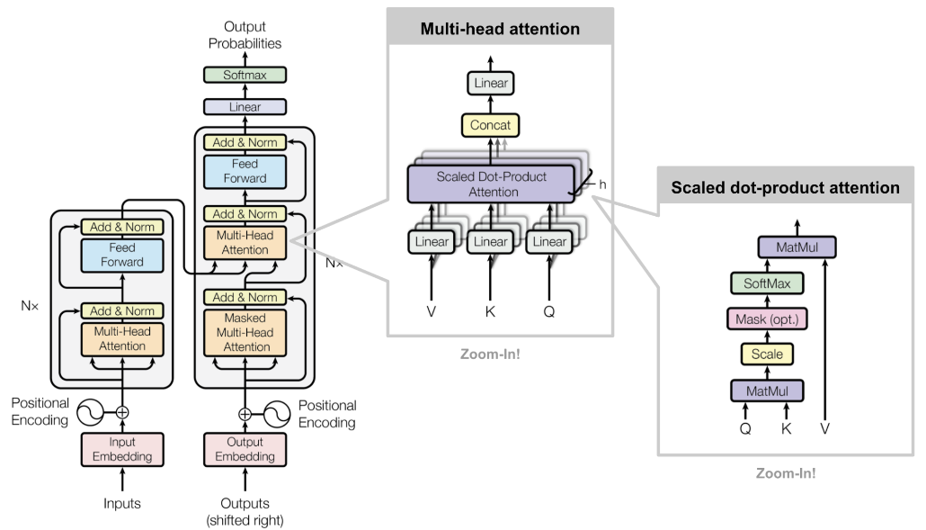
ATTENTION MECHANISM

Slide 14
SCALED DOT PRODUCT ATTENTION

Slide 15
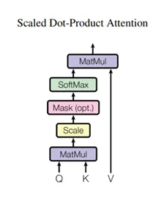

SCALED DOT PRODUCT ATTENTION
The attention function used by the transformer takes three inputs: Q (query), K (key), V (value). The equation used to calculate the attention weights is:
Query vector: Represented by a word vector in the sequence and defines the hidden state of the decoder.
Key vector: Represented by all the words in the sequence and defines the hidden state of the encoder.
Value vector: Represented by all the words in the sequence and defines the attention weights of the encoder hidden states.
The dot-product attention is scaled by a factor of square root of the depth. This is done because for large values of depth, the dot product grows large in magnitude pushing the softmax function where it has small gradients resulting in a very hard softmax.

Slide 16
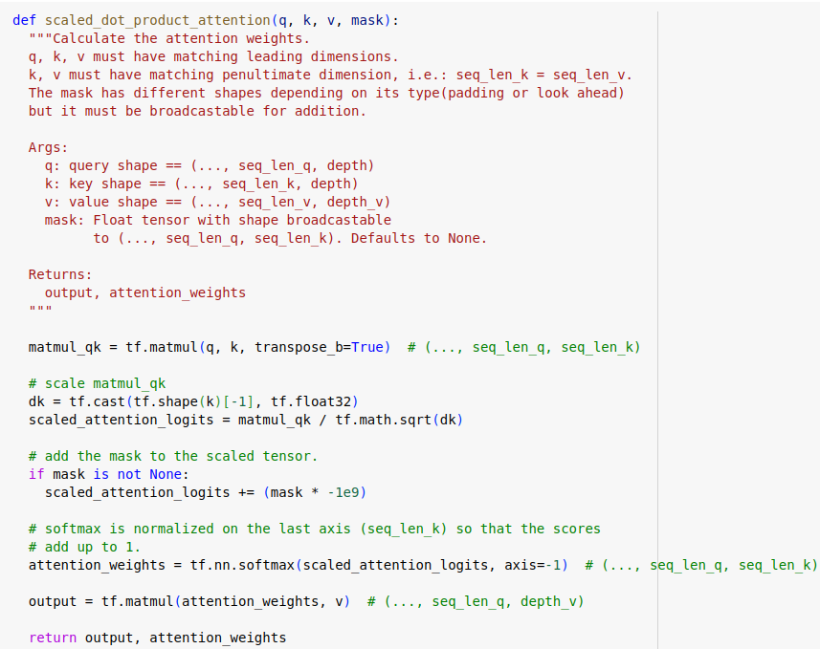
SCALED DOT PRODUCT ATTENTION

Slide 17
MULTI HEAD ATTENTION

Slide 18
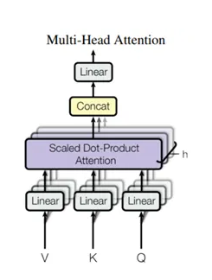
MULTI HEAD ATTENTION
Multi-head attention consists of four parts: Linear layers and split into heads, Scaled dot-product attention, Concatenation of heads, Final linear layer . Each multi-head attention block gets three inputs; Q (query), K (key), V (value). These are put through linear (Dense) layers and split up into multiple heads.
The scaled_dot_product_attention defined above is applied to each head (broadcasted for efficiency). An appropriate mask must be used in the attention step. The attention output for each head is then concatenated and put through a final Dense layer.
Instead of one single attention head, Q, K, and V are split into multiple heads because it allows the model to jointly attend to information from different representation subspaces at different positions. After the split each head has a reduced dimensionality, so the total computation cost is the same as a single head attention with full dimensionality.
The output represents the multiplication of the attention weights and the V (value) vector. This ensures that the words we want to focus on are kept as-is and the irrelevant words are flushed out.

Slide 19
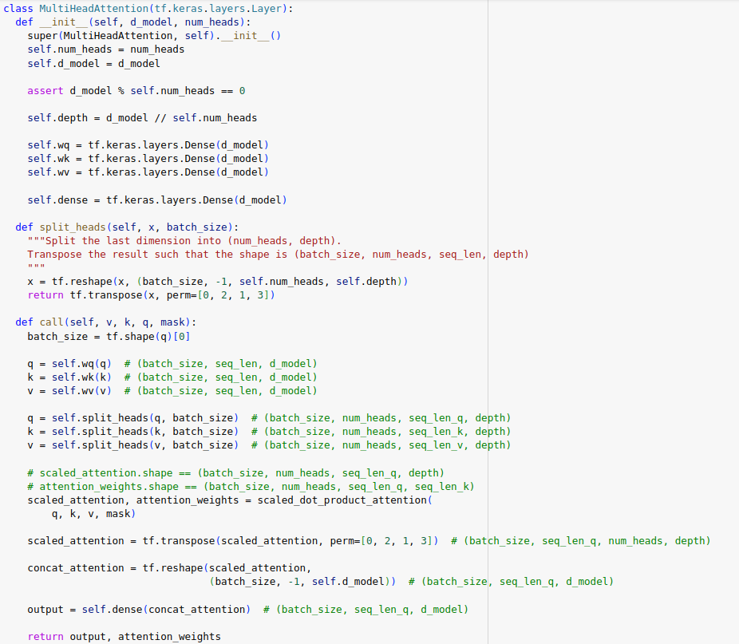
MULTI HEAD ATTENTION

Slide 20
MULTI HEAD ATTENTION

Slide 21
ENCODER

Slide 22
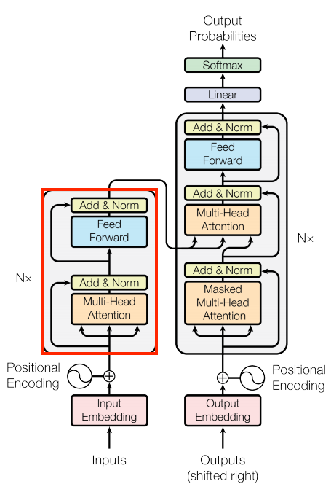
ENCODER LAYER
The encoder contains a stack of N encoder layers. Where each contains a GlobalSelfAttention and FeedForward layer
The encoder takes each word in the input sentence, process it to an intermediate representation and compares it with all the other words in the input sentence. The result of those comparisons is an attention score that evaluates the contribution of each word in the sentence to the key word. The attention scores are then used as weights for words’ representations that are fed the fully-connected network that generates a new representation for the key word. It does so for all the words in the sentence and transfers the new representation to the decoder that by this information can have all the dependencies that it needs to build the predictions.

Slide 23
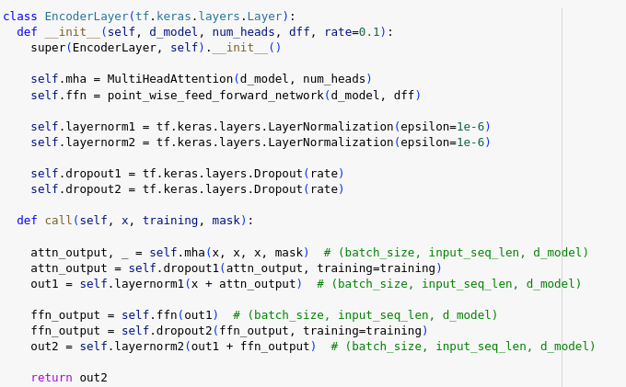
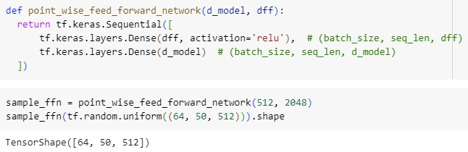
ENCODER LAYER

Slide 24
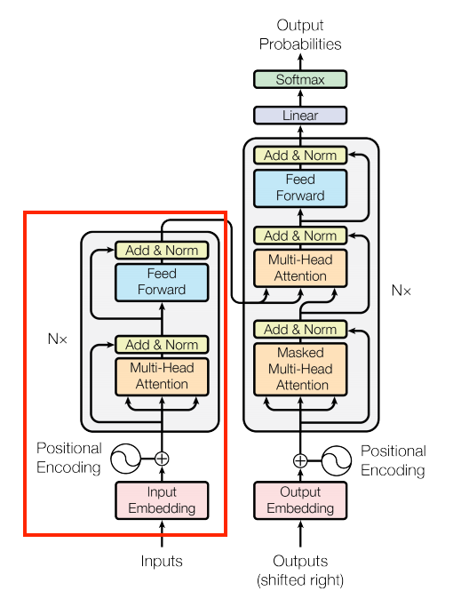
ENCODER
The encoder consists of:
A PositionalEmbedding layer at the input.
A stack of EncoderLayer layers.
The encoder receives the embedding vectors as a list of vectors, each of 512 (can be tuned as a hyper-parameter) size dimension. Both the encoder and the decoder add a positional encoding (that will be explained later) to their input. Both also use a bypass that is called a residual connection followed by an addition of the original input of the sub-layer and another normalization layer (which is also known as a batch normalization)

Slide 25
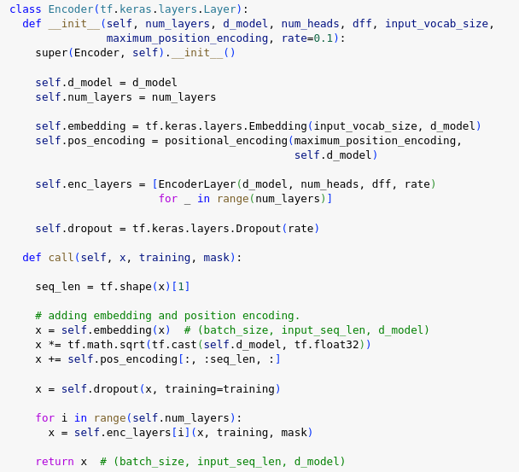
ENCODER

Slide 26
DECODER

Slide 27
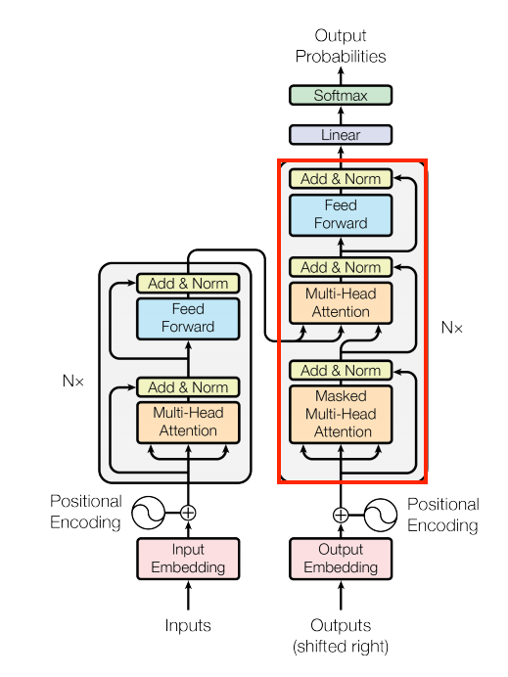
DECODER LAYER
The decoder's stack is slightly more complex, with each DecoderLayer containing a CausalSelfAttention, a CrossAttention, and a FeedForward layer
Similar to the Encoder, the Decoder consists of a PositionalEmbedding, and a stack of DecoderLayers
Unlike the encoder, the decoder uses an addition to the Multi-head attention that is called masking. This operation is intended to prevent exposing posterior information from the decoder. It means that in the training level the decoder doesn’t get access to tokens in the target sentence that will reveal the correct answer and will disrupt the learning procedure. It’s really important part in the decoder because if we will not use the masking the model will not learn anything and will just repeat the target sentence.

Slide 28
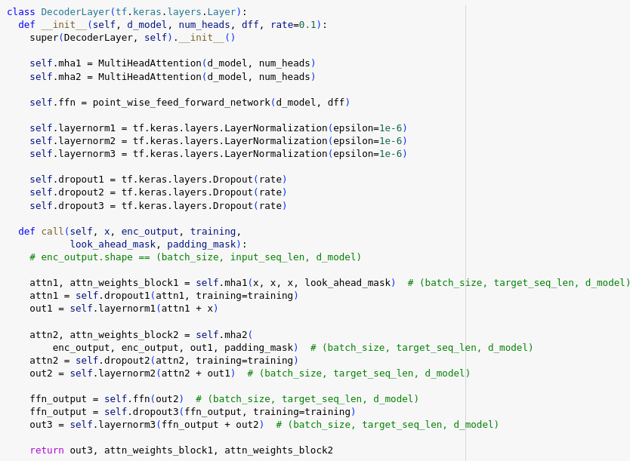
DECODER LAYER

Slide 29
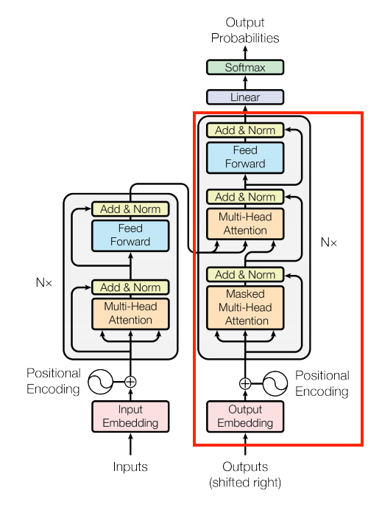
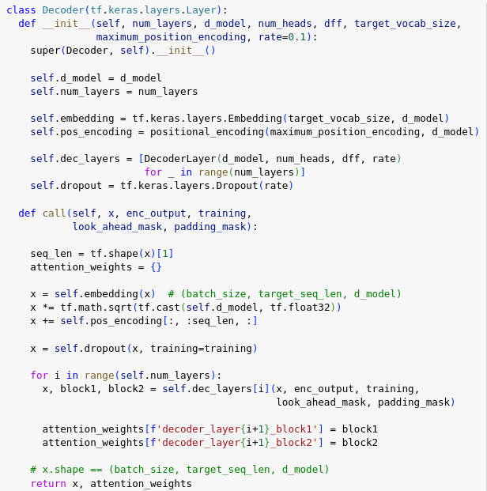
DECODER

Slide 30
TRANSFORMER

Slide 31
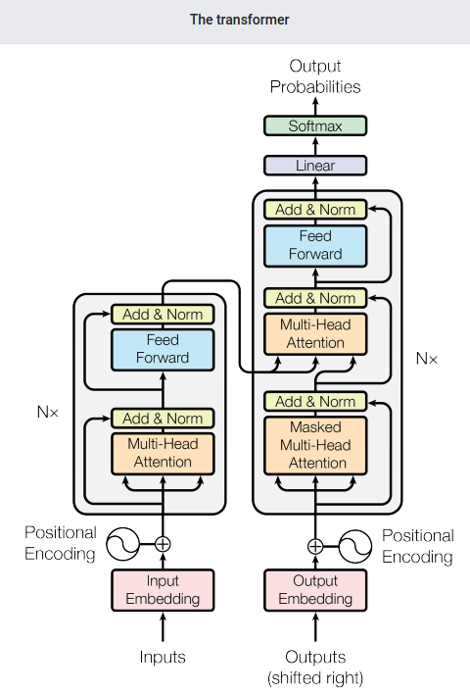
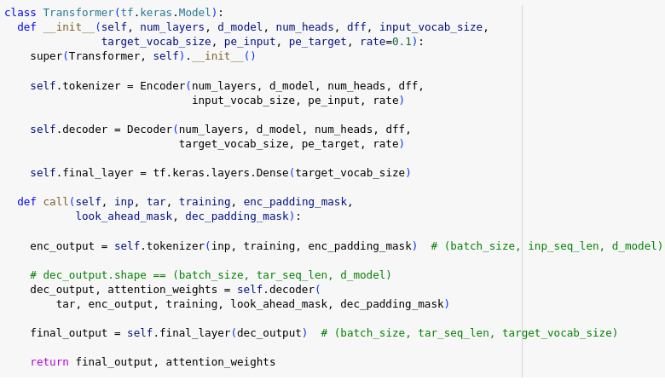
TRANSFORMER
We now have Encoder and Decoder. To complete the Transformer model, we need to put them together and add a final linear (Dense) layer which converts the resulting vector at each location into output token probabilities.
The output of the decoder is the input to this final linear layer.

Slide 32
TIMELINE

Slide 33
TIMELINE
Oct. 2023
Dataset Preparation
Data Preprocessing
Nov. 2023
Creating Vocab File
Custom tokenizer
Dec. 2023
Building Attention Mechanism
Jan. 2024
Encoder Layer
Feb. 2024
Decoder Layer
Mar. 2024
Transformer
Training and testing
Apr. 2024
Deployment
May. 2024

Slide 34
CONCLUSION AND FUTURE WORK

Slide 35
CONCLUSION AND FUTURE WORK
In conclusion, our team's next crucial step involves training the model and evaluating its performance using the BLEU score metric. This evaluation will provide valuable insights into the accuracy and efficacy of our translation system. Upon achieving satisfactory results, we will proceed with the deployment phase, ensuring widespread accessibility and usability of our advanced English to Telugu translation tool.

Slide 36
WE Komal Reddy (20103005) Jayanth Reddy (20103010) Jnana Yasaswini (20103023) Akhila Banoth (20103052) AS A TEAM THANK YOU

